Slide 1
Web Scraping using R: Microbiome
By:
Vasanth Manne
Karthik Mohan
Anirudh Tallury

Slide 2
OBJECTIVE
Fundamental Concepts And Techniques Of Web Scraping, Including The Tools And Methods Involved
Utilize The R Programming Language To Extract Article Data From Online Journals
Cleaning And Preprocessing The Scraped Data To Ensure Accuracy And Reliability For Further Analysis
Collected Article Data, Including Summary Statistics, Trend Identification, And Pattern Recognition.
Create Visualizations And Derive Meaningful Insights From The Scraped Data

Slide 3
Scarping article Data
Extract article data from the Journal for a given year

Slide 4
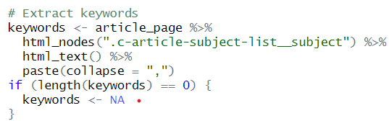
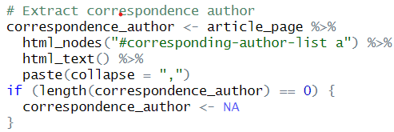
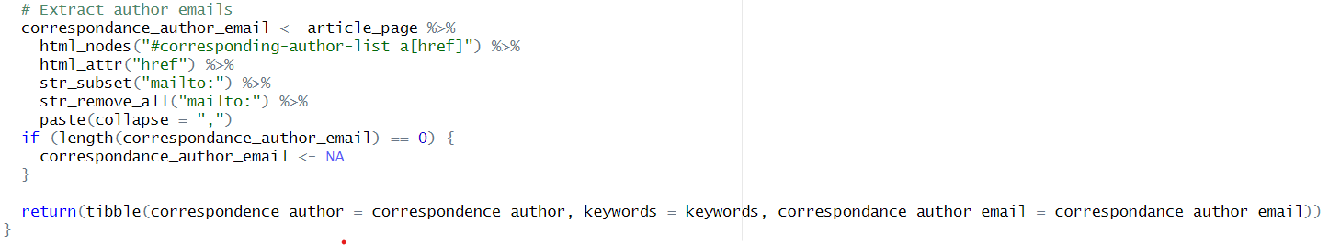
Fields to Extract
Title, Authors, Correspondence Author, Correspondence Author's Email, Publish Date, Abstract, Keywords

Slide 5

Data pre-processing
Clean and preprocess scraped data.
Handle missing values and irrelevant information.
Format data for analysis

Slide 6
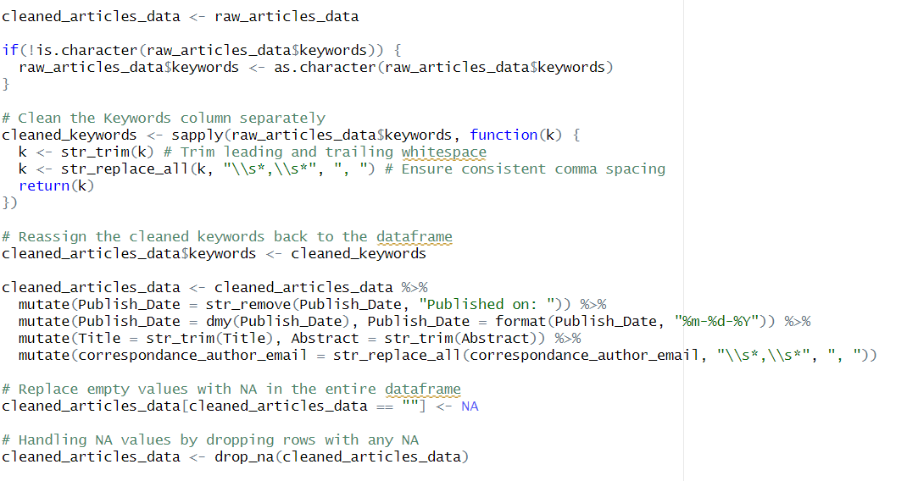
Data Cleaning Process Overview
Drops rows containing any NA values using drop_na function from tidyr package, effectively handling missing data.
Converts the Publish_Date to a Date object using dmy from lubridate package, and then formats it to "mm-dd-yyyy" using format.

Slide 7

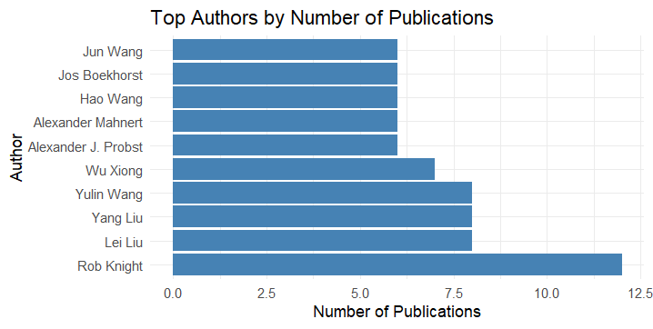
Data Analysis and Visualization

Slide 8
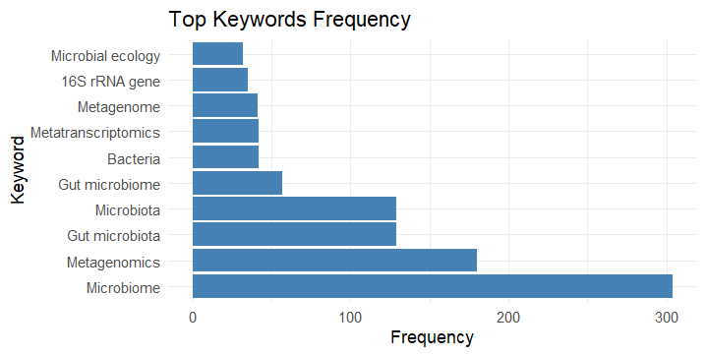
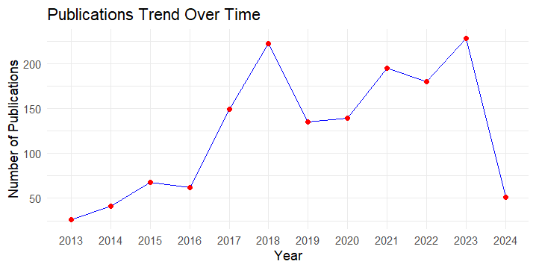

Slide 9
Summary: Web Scraping, Data Preprocessing, and Visualization
Web Scraping:
Utilizes libraries like rvest, dplyr, stringr, purrr, and xml2 for web scraping from a journal's website.
Defines functions to safely read HTML from URLs, extract data from individual article pages, and retrieve articles data from multiple pages.
Data Preprocessing:
Cleans the extracted articles data, focusing on standardizing the format of keywords, publication dates, titles, abstracts, and correspondence author emails.
Ensures consistency by trimming leading and trailing whitespaces, replacing inconsistent comma spacing, and formatting dates appropriately.
Visualization:
Visualizes trends in publications over time through a line plot depicting the number of publications per year.
Identifies and visualizes the frequency of top keywords and authors using bar charts, providing insights into popular research topics and prolific authors within the dataset.

Slide 10
Thank you
By:
Vasanth Manne
Karthik Mohan
Anirudh Tallury

